Slide 1
SPAM SMS Classification
Report Summary
Submitted by:
SANTOSH H. HULBUTTI
Intern @ Flip Robo Technologies

Slide 2
The Problem Statement
The development of the cell phone has prompted a sensational increment in SMS spam messages. Despite the fact that in many parts of the world, versatile informing channel is right now viewed as "spotless" and trusted, on the complexity ongoing reports obviously show that the volume of cell phone spam is drastically expanding step by step. Spam separating is a similarly late errand to arrangement such an issue. It acquires numerous worries and convenient solutions from SMS spam separating.
Our goal is to build a NLP machine learning model which will be able to classify the text messages as spam or ham.

Slide 3
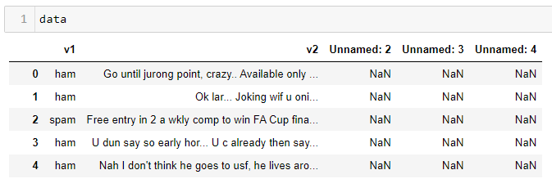
Understanding the problem & dataset
Short Message Services (SMS) is far more than just a technology for a chat. SMS technology evolved out of the global system for mobile communications standard, an internationally accepted. Spam is the abuse of electronic messaging systems to send unsolicited messages in bulk indiscriminately. SMS Spam in the context is very similar to email spams, typically, unsolicited bulk messaging with some business interest. SMS spam is used for commercial advertising and spreading phishing links. Commercial spammers use malware to send SMS spam because sending SMS spam is illegal in most countries.
The data set includes following features:
v1: It is the Label column, which includes values 0 and 1, denoting if the message is ham or spam respectively.
V2: It denotes text messages.
All other 3 columns are dropped after feature analysis.

Slide 4
Preprocessing Steps
Convert the text to lowercase
Remove the punctuations, digits and special characters
Tokenize the text, filter out the adjectives used in the review and create a new column in data frame
Remove the stop words
Stemming and Lemmatization
Applying Text Vectorization to convert text into numeric
Applying label encoder on target feature
Apply the oversampling method to balance the dataset.

Slide 5
Visualizations
Plots used for Data Visualization:
Distribution plots
Count plots
Scatterplot
Bar plots
Word Clouds

Slide 6
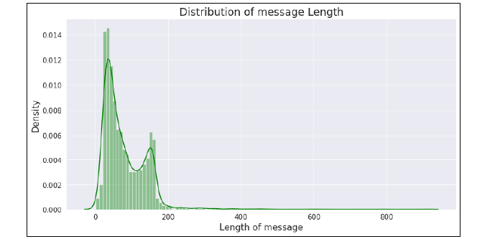
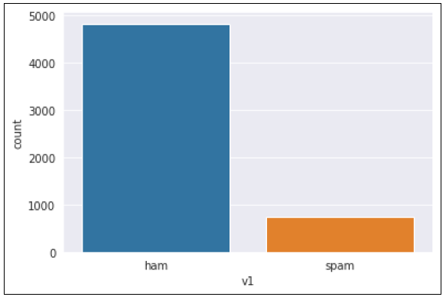
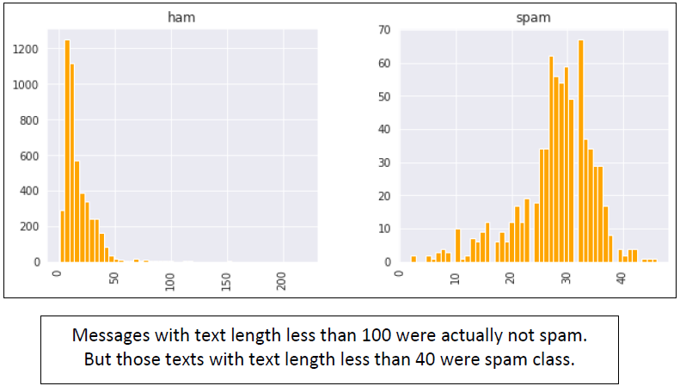
Distribution of Length of messages
Overall, the dataset has text messages varying from 0 to 200 text length. Those above 200 are seem to be outliers.
From uncleaned data
Data was highly biased towards ham class. We applied SMOTE to balanced the class for Machine learning models.

Slide 7
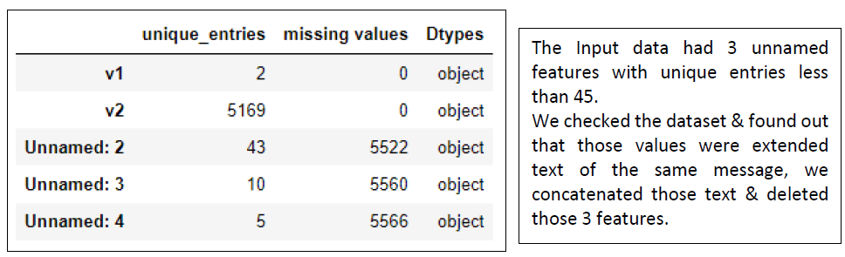
Feature Engineering on unlabeled features:

Slide 8
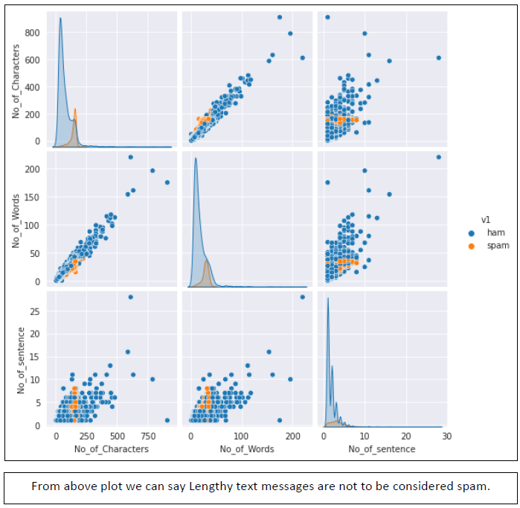
Checking relation between length of spam & ham text messages
From above plot we can say Lengthy text messages are not to be considered spam.

Slide 9
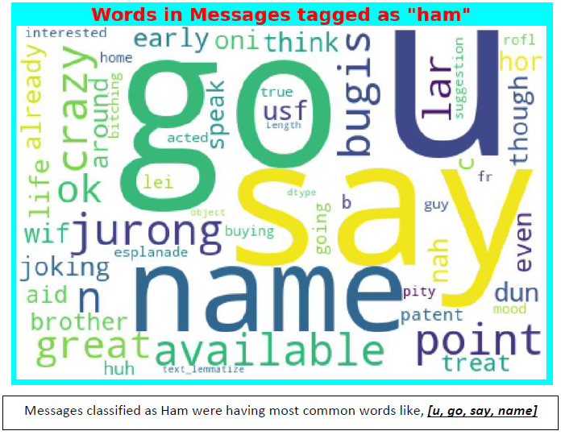
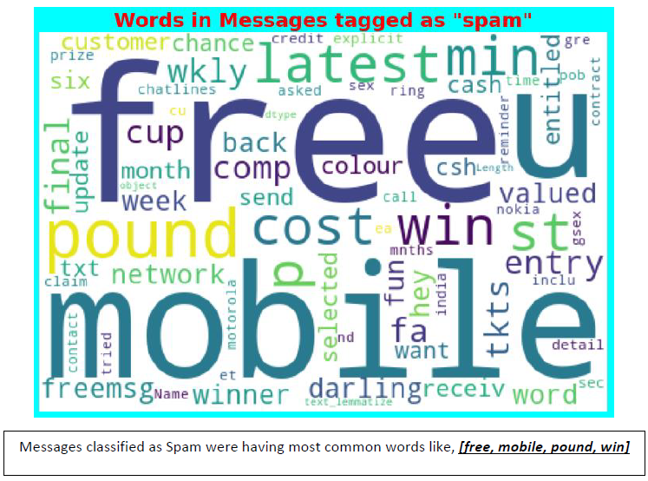
Word Clouds

Slide 10
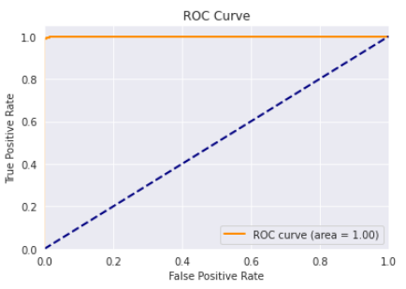
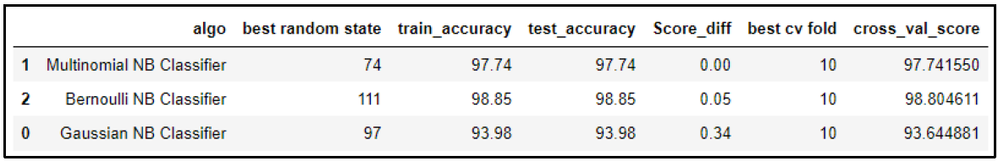
Finalized Model
Model Selection Table
We selected sklearn’s Tfidf Vectorizer as a text vectorization method & Bernoulli NB Classifier as final model for the following reasons:
• Maximum ACCURACY with high Precision value.
• Maximum Value of area under ROC curve

Slide 11
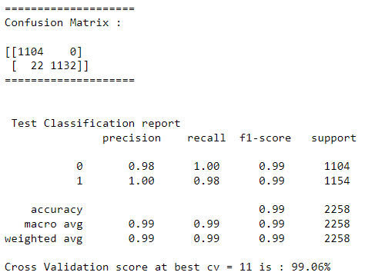
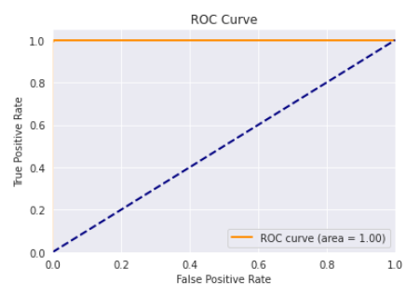
Finalized Model
Hyper parameter tuned model

Slide 12
Conclusion
Messages with Lengthy text are not to be considered spam., but those texts with text length less than 40 were of spam class.
Messages classified as Ham were having most common words like, [u, go, say, name]
Messages classified as Spam were having most common words like, [free, mobile, pound, win]
Naïve bayes algorithms are best for spam classification problems.
LSTM model does not perform better as compared with all 3 naïve bayes model used in the project.
Bernoulli Naïve Bayes Classifier Model gives the best result so we save this model as our final model for future data/message predictions.

